Slide 1
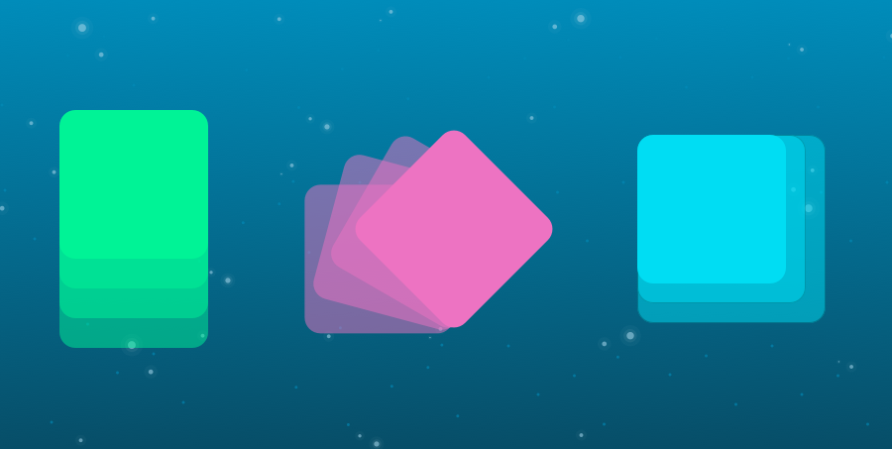
Transformations, Transitions and Animations
SoftUni Team
Technical Trainers
Software University
https://softuni.org

Slide 2
Table of Contents
Transformations
Transform Properties
Transitions
Transition Properties
Timing Functions
Animations
Animation Properties
Keyframes
Notes:
2

Slide 3
Have a Question?
sli.do
#front-end
Notes:
3

Slide 4
Transformations
Rotate, Scale, Move, Skew, Etc., Elements

Slide 5
CSS Transformations
The transform property applies a 2D or 3D transformation to an element
This property allows you to:
Rotate
Scale
Move
Skew
div.a {
transform: rotate(20deg);
}

Slide 6
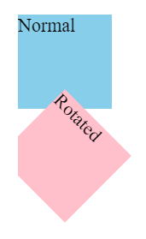
CSS Transformations - Rotate
The rotate() CSS function defines a transformation that rotates an element around a fixed point
<div>Normal</div>
<div class="rotated">Rotated</div>
div {
width: 80px;
height: 80px;
background-color: skyblue;
}
.rotated {
transform: rotate(45deg);
background-color: pink;
}

Slide 7
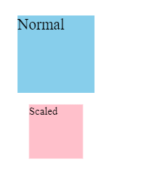
CSS Transformations - Scale
The scale() CSS function defines a transformation that resizes an element
<div>Normal</div>
<div class="scaled">Scaled</div>
div {
width: 80px;
height: 80px;
background-color: skyblue;
}
.scaled {
transform: scale(0.7);
background-color: pink;
}

Slide 8
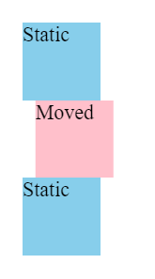
CSS Transformations - Translate
The translate() CSS function repositions an element in the horizontal and/or vertical directions
<div>Static</div>
<div class="moved">Moved</div>
<div>Static</div>
div {
width: 60px;
height: 60px;
background-color: skyblue;
} .moved {
transform: translate(10px); background-color: pink;
}

Slide 9
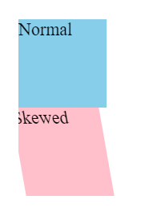
CSS Transformations - Translate
The skew() function defines a transformation that skews an element
<div>Normal</div>
<div class="skewed">Skewed</div>
div {
width: 80px;
height: 80px;
background-color: skyblue;
}
.skewed {
transform: skew(10deg);
background-color: pink;
}

Slide 10
Transformation Properties
none - Defines that there should be no transformation
matrix(n,n,n,n,n,n) - Defines a 2D transformation, using a matrix of six values
translate(x,y) - Defines a 2D translation
translateX(x) - Defines a translation, using only the value for the X-axis
translateY(y)- Defines a translation, using only the value for the Y-axis

Slide 11
Transformation Properties
scale(x,y) - Defines a 2D scale transformation
rotate(angle) - Defines a 2D rotation, the angle is specified in the parameter
skew(x-angle,y-angle) - Defines a 2D skew transformation along the X- and the Y-axisa
perspective(n) - Defines a perspective view for a 3D transformed element
initial - Sets this property to its default value
inherit - Inherits this property from its parent element

Slide 12
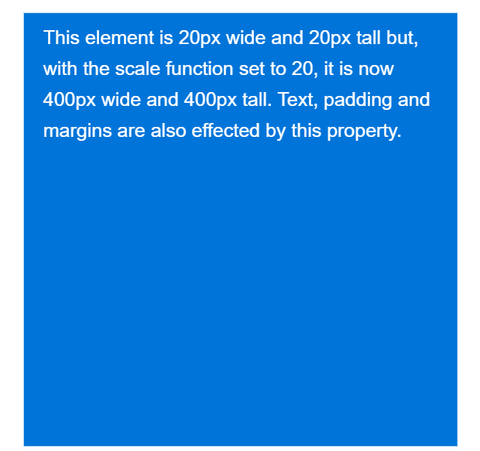
Transform Example
Even with a declared height and width, this element will now be scaled to twenty times its original size
.element {
width: 20px;
height: 20px;
transform: scale(20);
}

Slide 13
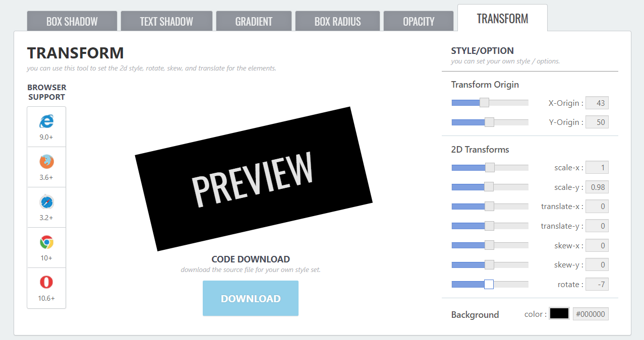
Transform Generator
A Transform CSS Generator that helps you quickly generate transform CSS declarations

Slide 14
CSS Transitions
Change Property Values Smoothly, Over a Given Duration

Slide 15
CSS Transitions
Allows you to change property values smoothly, over a given duration
Instead of having property changes take effect immediately, you can cause the changes in a property to take place over a period of time

Slide 16
CSS Transitions
If you change the color of an element from white to black, usually the change is instantaneous
With CSS transitions enabled, changes occur at time intervals that follow an acceleration curve, all of which can be customized

Slide 17
Transition Properties
transition
transition-delay
transition-duration
transition-property
transition-timing-function
Transitions - Shorthand
/* property name | duration | timing function | delay */
transition: color 4s ease-in-out 1s;

Slide 18
Transitions - Timing Functions
Mathematical function that describes how fast one-dimensional values change during animations
This lets you vary the animation's speed over the course of its duration
"Smooth" timing functions are often called easing functions
They correlate a time ratio to an output ratio, both expressed as s
For these values, 0.0 represents the initial state, and 1.0 represents the final state

Slide 19
Ease Out
Easing out causes the animation to start more quickly than linear ones, and it also has deceleration at the end
Good for user interface work
The fast start gives your animations a feeling of responsiveness, while still allowing for a natural slowdown at the end
transition: transform 500ms ease-out;

Slide 20
Ease In
Start slowly and end fast
Have the detrimental effect of feeling sluggish when starting, which negatively impacts the perception of responsiveness in your site
transition: transform 500ms ease-in;

Slide 21

Problem: Box Change
Update the following box properties with transition ease effect:
width;
height;
background-color;
font-size;
left;
top;
color;

Slide 22
Animations
Animate the Values of CSS Properties

Slide 23
CSS Animations
A module that lets you animate the values of CSS properties over time, using keyframes
The behavior of these keyframe animations can be controlled by specifying their:
Timing function
Duration
Number of repetitions
Other attributes

Slide 24
Keyframes
The @keyframes CSS at-rule controls the intermediate steps in a CSS animation sequence by defining styles for keyframes along the animation sequence
This gives more control over the intermediate steps of the animation sequence than transitions

Slide 25
Keyframes - Example
@keyframes slideIn {
from {
transform: translateX(-20rem);
opacity: 0;
}
to {
transform: translateX(0);
opacity: 1;
}
}

Slide 26
Keyframes - Example
@keyframes slideIn {
0% {
transform: translateX(-20rem);
opacity: 0;
}
50% {
transform: translateX(10rem);
}
100% {
transform: translateX(0);
opacity: 1;
}
}

Slide 27
Animations – Properties
animation-delay - Configures the delay between the time the element is loaded and the beginning of the animation sequence
animation-direction - Configures whether the animation should alternate direction on each run through the sequence or reset to the start point and repeat itself
animation-duration - Configures the length of time that an animation should take to complete one cycle

Slide 28
Animations – Properties
animation-iteration-count - Configures the number of times the animation should repeat
You can specify infinite to repeat the animation indefinitely
animation-name - Specifies the name of the @keyframes at- rule describing the animation’s keyframes
animation-play-state - Lets you pause and resume the animation sequence

Slide 29
Animations – Properties
animation-timing-function - Configures the timing of the animation
That is, how the animation transitions through keyframes, by establishing acceleration curves
animation-fill-mode - Configures what values are applied by the animation before and after it is executing

Slide 30
Animation - Example
div {
width: 100px;
height: 100px;
background-color: red;
animation-name: example;
animation-duration: 4s;
}
@keyframes example {
from {
background-color: red;
}
to {
background-color: yellow;
}
}

Slide 31
Problem: Circle to Box Animation
Create a small red circle
Center the circle in the viewport
Animate that circle to a square and back to circle

Slide 32
Problem: Fancy List Animation
Create a list of items with icons
Animate the showing of each element
Use animation-delay to make the appearance of the elements staggered

Slide 33
Problem: Animating Gradients
Create an empty div element
Use :before and :after pseudo elements with position absolute to make them as big as their container
Add different gradients on the :before and :after elements
Animate between the different gradients by using opacity on the top most element

Slide 34
Problem: Animating Gradients

Slide 35

Summary
Transformations
Transform Properties
Transitions
Transition Properties
Timing Functions
Animations
Animation Properties
Keyframes
Notes:
35

Slide 36
Questions?
Notes:
36

Slide 37














SoftUni Diamond Partners

Slide 38

License
This course (slides, examples, demos, exercises, homework, documents, videos and other assets) is copyrighted content
Unauthorized copy, reproduction or use is illegal
© SoftUni – https://softuni.org
© Software University – https://softuni.bg
Notes:
38

Slide 39
Trainings @ Software University (SoftUni)
Software University – High-Quality Education, Profession and Job for Software Developers
softuni.bg
Software University Foundation
softuni.foundation
Software University @ Facebook
facebook.com/SoftwareUniversity
Software University Forums
forum.softuni.bg
Notes:
39

